Slide 1
Louisiana Tech Capstone
Cyber Security Situational Awareness System
Submitted by Capstone 2010

Slide 2
Overview
Project Objectives
High Level Overview
Project Management Strategies
Risk Analysis
Component Overview
Lessons Learned
Conclusion

Slide 3
Project Objectives
Apply knowledge of computing and design to solve the given Problem
Employ proper communication and teamwork skills
Perform research on related topics to gain a full understanding of the problem

Slide 4
High Level Overview
Cyber Situational Awareness System
3 Core Components
  Score Server Back End
    Provides Real Times Scoring
  Score Server Front End
    Provides a nice User interface and administrative panel
  Real Time Traffic Visualization System
    Consists of Back End and Graphical Front End
    Animation of Network Status

Slide 5
Project Management Strategies
Iterative Software Development Model
  Planning, Analysis and Design, Testing, Evaluation
  Allows for rapid development
  More Suitable to research based development
  Deadline driven development
Tools
  Project Timeline Gannt Chart
  Iteration Tracker
  Issue Tracker
  Google Code Repository and Wave

Slide 6
Risk Analysis and Mitigation
Medium Risk Project
  Compressed Timeline and High Complexity
    Iterative Development
    Weekly Branching
    Chain of Command
  Limited existing resources
    1 Week research period
    Appointing knowledgeable resources to each team

Slide 7
Component Overview: Score Server
To be filled in by teams

Slide 8
Component Overview: Score Server
Front End
To be filled out by teams
Notes:
Objective

Slide 9
Component Overview: Real Time
Network Analysis
Objectives
Maintain real-time awareness of active network nodes
Detect possible attacks and remote login attempts across network
Visualize real-time network traffic
Present results to Front End for display

Slide 10
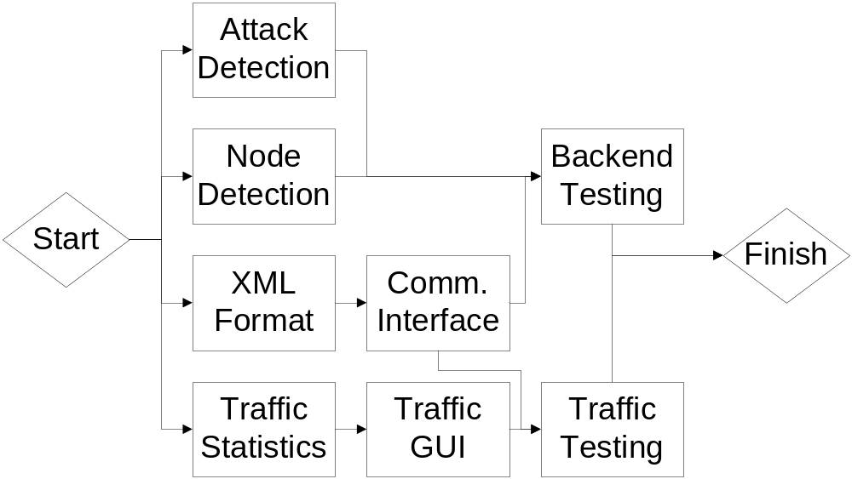
Component Overview: Real Time
Network Analysis
Real-time Network Analysis Abbreviated PERT Chart

Slide 11
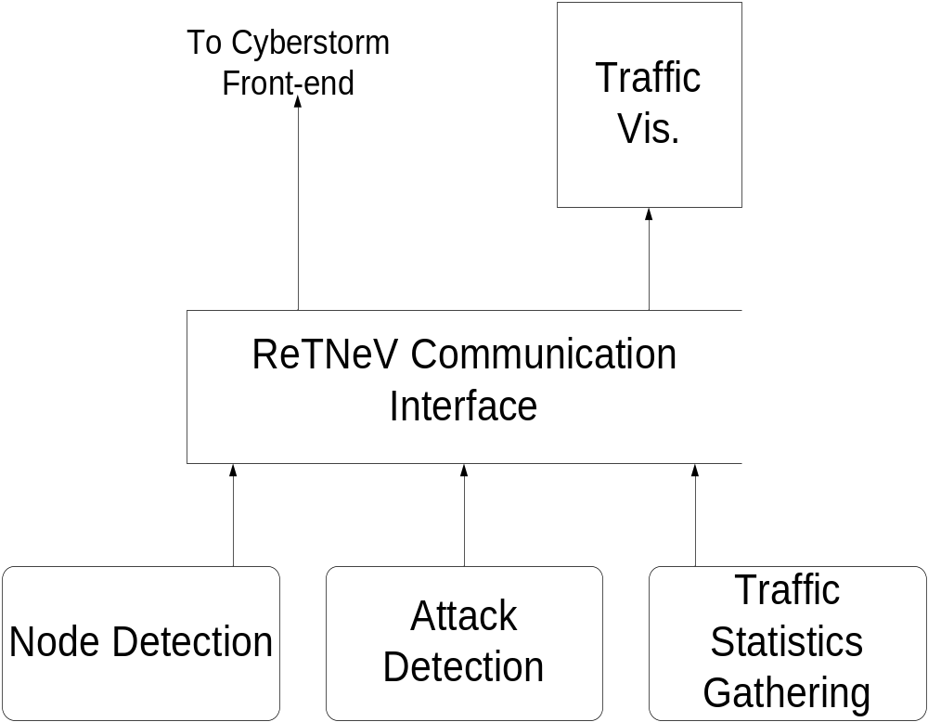
Component Overview: Real Time
Network Analysis
Real-time Network Analysis Data Flow Diagram

Slide 12
Component Overview: Real Time
Network Analysis
Node Detection
Uses bash scripting
Uses Nmap for port scanning
Expands to multiple network configurations
Detects and caches OS information
Detects running services

Slide 13
Component Overview: Real Time
Network Analysis
Attack Detection
Provides the audience a way to view attacks across the network.
Uses Snort Intrusion Detection System for deep packet inspection
Parses snort alert files to gain all of the pertinent information
Sends the information to a database for communication with front end

Slide 14
Component Overview: Real Time
Network Analysis
Traffic Statistics
Uses IPTraf for byte level traffic reports
Reads traffic between subnets (teams)
Uses Javascript front-end
Displays real-time current traffic
Displays total traffic information

Slide 15
Component Overview: Real Time
Network Analysis
Communications Interface
Log Parsing
Database Management
XML generation

Slide 16
Component Overview: Real Time
Network Analysis
Lessons Learned
Found scope creep to be an issue
Learned importance of synchronized development
Used new tools and techniques

Slide 17
Lessons Learned
Iterative Development – Great for time compressed and research driven projects
Real World Pressure of Must deliver deadlines

Slide 18
Summary
Project Objectives
High Level Overview
Project Management Strategies
Risk Analysis
Component Overview
Lessons Learned
Conclusion

Slide 19
Questions?

